Slide 1


GENERATING NARRATIVE
Presented by : Supriyo Pal, Trina Chowdhury, Hadiya Mushtaq, Ishita Das, Bharadwaj V, Sanjay Babu C. S
Project Mentor(s): Ishpreet Kaur, Kuljeet Singh & Sundeep Narwani.

Slide 2

Problem Statement
This project aims to streamline the creation of multimedia narratives by automating the process of generating stories, images, voiceovers, and videos from simple text prompts. It addresses the challenge of separately handling text, visuals, and audio for content creation. By integrating these elements into a seamless workflow, users can easily generate engaging, high-quality video narratives. This approach to storytelling is highly effective and particularly
appealing to younger audiences, especially children, making it an ideal tool for
captivating and interactive content creation.

Slide 3



Project Objectives
Crafting Captivating Short Stories
Use LLMs to generate coherent and creative short stories from prompts. It focuses on ensuring narrative flow, character development, and thematic consistency in the stories.
Generate Images Based on the Story
Use AI tools to create images that visually represent key elements or scenes in the narrative, enhancing the storytelling experience.
Convert Text to Speech (TTS)
Utilize text-to-speech (TTS) technology to convert the refined text into natural- sounding, personalized speech, ensuring high quality for interactive content.

Slide 4
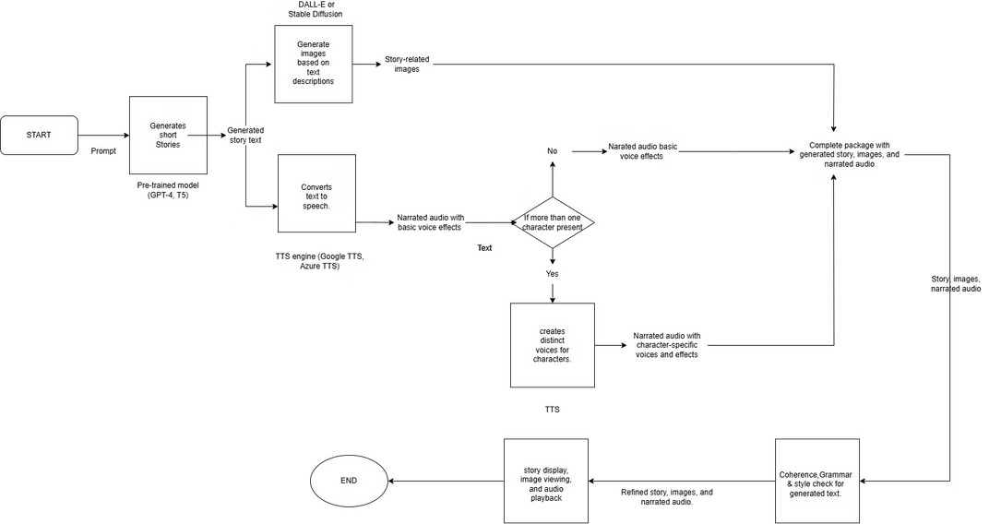
Project Flow

Slide 5

Data Collection & Understanding
Data Source
The data for this analysis comes from a US election news article containing claims made by Donald Trump. The claims were sourced from a CNN article titled "Fact-check: Trump and Musk make 20 false claims in one day."
Analysis and Observed Patterns
The analysis revealed five consistent patterns in Trump's claims: exaggeration of figures, misrepresentation of facts, misleading attribution of actions or roles, assertions without evidence, and undermining established facts or processes.
Conclusion
These patterns suggest a tendency to dramatize issues, cast doubt on opponents, and reinforce Trump's perspective, often at the cost of factual accuracy.

Slide 6

Methodology
Model Selection
The Phi-3-mini-128k-instruct model was chosen for its ability to follow structured instructions and generate nuanced, complex narratives. This model is optimized for instruction-following
tasks, which helps ensure that the output matches the detailed
prompt constraints.
1
Parameter Tuning
Parameter choices were made to ensure that outputs are factually consistent, persuasive, and structured according to the prompt. These parameters include do_sample, temperature,
max_new_tokens, and return_full_text.
2
Feature Engineering
Feature engineering focuses on defining a critical tone, style guidelines, content constraints, word limit and length control, instructional constraints, and language and vocabulary choice.
3

Slide 7

Code Snippet for Parameter Tuning
import torch from transformers
import AutoModelForCausalLM, AutoTokenizer, pipeline torch.random.manual_seed(0) model = AutoModelForCausalLM.from_pretrained ( "microsoft/Phi-3-mini-128k-instruct", device_map="cuda", torch_dtype="auto", trust_remote_code=True, ) tokenizer = AutoTokenizer.from_pretrained("microsoft/Phi-3-mini-128k-instruct") prompt = """ """ pipe = pipeline( "text-generation", model=model, tokenizer=tokenizer, ) generation_args = { "max_new_tokens": 2000, "return_full_text": False, "temperature": 0.8, "do_sample": False,} output = pipe(prompt, **generation_args) print(output[0]['generated_text'])

Slide 8

Model Performance
1
Generation Quality and Coherence: The model produced a coherent and structured
narrative that clearly addressed the prompt’s
requirements. It followed a logical flow, including
vivid descriptions, relevant dates, and historical facts
to create a counter-narrative against Trump’s claim.
The model successfully captured the essence of the
US-Afghan military involvement, detailing both the
$7.1 billion figure for abandoned equipment and the
broader context of US spending over time, adding
depth to the counter-argument.
Prompt Adherence and Instruction Following The model is containing a specific word count (200–
400 words) and an aggressive, fact-based tone. The
model adhered well to these constraints, providing a
narrative that was both assertive and historically
detailed, without deviating from the central theme.
The generated output respected the instructions to
avoid rephrasing the provided facts, instead
incorporating original supporting details, thus
meeting the prompt's demand for a unique counter-
narrative.
2
3
Assessment of Tone:
4
Overall Model Suitability:
The requested tone was aggressive and assertive, aiming to refute the claim directly. The model achieved this by using strong, direct language to convey confidence and authority. Terms like “tarnish the historical record” and “misleading figure” reinforce the assertive tone, aligning well with the
prompt’s demand for a powerful, confrontational
stance. The narrative’s tone maintained an
appropriate level of intensity, making the counter-
narrative more compelling.
The Phi-3-mini-128k-instruct model was well-suited for this task due to its capability to follow complex instructions and maintain specified tones. By setting parameters like temperature=0.8 and do_sample=True, the model balanced creativity with
assertiveness, making the narrative both engaging
and impactful. The use of device_map="cuda"
accelerated generation, which contributed to
efficient output production while preserving quality.

Slide 9

Areas of Improvement for Output Quality
1
Fine-Tuning Temperature for Tone
Control
The current temperature=0.8 balances creativity with coherence, but lowering it slightly (e.g., to 0.6 or 0.7) may improve tone consistency. Lowering the temperature can make the language more direct, which may better support an assertive tone. Testing with different temperatures can help find an optimal level that maintains creativity while focusing the model’s attention on the prompt’s assertive nature
2
Top-p and Top-k Sampling Adjustments
Adding top-p (nucleus) sampling or top-k sampling can further guide the model’s choice of words, ensuring the output remains focused and assertive. Setting top_p=0.9 or top_k=50 could help achieve a more aggressive and assertive tone.
3
Prompt Structuring for Tone Emphasis
To further enforce the desired tone, consider restructuring the prompt by explicitly describing the tone. This can help the model focus on the tone as a priority, not just the content.
4
Experiment with Different Lengths
If the outputs tend to be either too verbose or too concise, adjusting max_new_tokens can help control the response length and tone intensity. For a punchier narrative, try shortening the output by setting max_new_tokens to around 500–1000 tokens.

Slide 10

Insights and Key Features Used for Generating Prompts and Output
Model Selection
We selected the microsoft/Phi-3-mini-128k- instruct model, which is specifically tuned for tasks like storytelling and
generating coherent text
from prompts. This model
has been designed to
understand complex instructions and respond in a narrative style, making it ideal for creating compelling and detailed counter-narratives.
Prompt Structuring
A well-structured prompt was critical in guiding the model to produce assertive, historically accurate counter-narratives. For
instance, our prompt
explicitly outlined a claim,
factual counterpoints, and
instructions for an aggressive tone.
Text Generation Parameters
Setting temperature=0.8 was a strategic choice to introduce creativity while maintaining control over coherence. This parameter
balanced originality in
language without making
the output too random or
divergent from the main topic.
Device and Memory Optimization
By setting device_map="cuda", we ensured faster generation by leveraging GPU capabilities, significantly
reducing runtime and
enhancing efficiency. This
setting allowed for smooth
operation, even when generating longer narratives, by distributing the model load effectively on the hardware.

Slide 11

Challenges in Narrative Generation
1
Maintaining Cohesive Structure
2
Handling Large Context
It was observed that parts of the counter-narrative were missing, causing it to end abruptly. The remaining sections were absent from the output, leaving the narrative incomplete.
Keeping the narrative cohesive was challenging because extraneous content was being added along with the counter-narrative. This resulted in a disjointed and confusing narrative.
3
Balancing Creativity and Instruction- following
Generating narratives that are imaginative but still adhere to user instructions or prompts without going off-topic is a significant challenge. This requires a delicate balance between creativity and adherence to
instructions.
4
Controlling Narrative Flow and Structure
Ensuring a logical progression in the storyline, which includes a clear beginning, middle, and end, and smoothly transitioning between scenes or ideas is
crucial for a compelling narrative.

Slide 12

Solutions to Narrative Generation Challenges
Maintaining Cohesive Structure
To address the challenge, promote a style that aligns well with the phi3 model. Utilize targeted prompting techniques to enhance cohesiveness. This approach ensures a consistent and engaging narrative flow.
Handling Large Context
Increase the number of tokens to ensure the entire counter-narrative is captured without truncation. This allows the model to process and understand the full context of the story, leading to more accurate and comprehensive narratives.
Utilizing Feedback Loops for Consistency
Implement checkpoints where the model generates summaries of recent narrative parts. This can be used to reinforce consistency and context without re-processing the entire history. This approach ensures that the narrative remains coherent and consistent throughout.

Slide 13
Plan for Next Phase
Text-to-Image Generation
· Use advanced AI models to generate relevant visuals from narrative text, which will enhance storytelling by allowing users to “see” parts of the story.
· This step involves converting key narrative
descriptions or scenes into images that align with the
text's tone, context, and emotions, making the story
more engaging and vivid.
· Open LLMs such as Stable Diffusion or DALL-E can be
used to generate images from descriptive text. These
models can bring text-based narratives to life through
visuals that match the story’s context and tone.
Text-to-Audio Generation
· The text-to-speech or audio generation models to create background sounds, ambient noise, or even narrated segments that match the mood and setting of the narrative.
· This will add an auditory layer to the narrative, offering
users a richer, multi-sensory experience by immersing
them in the story’s environment or conveying emotions
through sound.
· Open LLMs like Bark or Tortoise TTS can be used for
audio generation. These models can help create
soundscapes, narration, or background sounds, adding
a rich auditory dimension to the narrative.

Slide 14

A heartfelt thank you for your time and consideration.

